Slide 1
Module 6
By
Nilanjan Byabarta

Slide 2
Sample questions on last slide

Slide 3
Content
Revisit System Design Goals
Levels of Parallelism
Instruction Level Parallelism
Super-scalar Architecture
Super-pipelined Architecture
VLIW Architecture
Vector Processor
SIMD Array Processor

Slide 4
Revisit Computer Architecture Design Goals
Key subsystems in a computer system are processors, memories, I/O interfaces and the data paths connecting them
Subsystem within the processors are functional units, registers, cache memories and internal data buses.
Computer Architecture is defined as the arrangement by which the various system building blocks are interconnected and inter-operated to achieve desired system performance
System performance is a key benchmark in the study of computer architecture – Parameters: Throughput, Response Time

Slide 5
Parallel Processing - Introduction
Parallel Processing: An efficient form of information processing which emphasizes the exploitation of concurrent events in the computing process. [Hwang, Briggs]
Types of Concurrency:
Parallelism – during same time interval
Simultaneity – at the same time instant
Pipelining – overlapped time spans
Parallel processing is a cost effective means to improve system performance through concurrent activities in the computer and reducing bottlenecks

Slide 6
Levels of Parallelism
Job or Program level
Task or procedure level
Inter-instruction level
Intra-instruction level

Slide 7
Instruction Level Parallelism
Instruction-level parallelism (ILP) of a program—a measure of the average number of instructions in a program that, in theory, a processor might be able to execute at the same time
Mostly determined by the number of true (data) dependencies and procedural (control) dependencies in relation to the number of other instructions
ILP is traditionally “extracting parallelism from a single instruction stream working on a single stream of data”

Slide 8
Parallelism in Uni-Processor System
Hardware approaches:
Parallelism and pipelining within the CPU –
Instruction & Arithmetic Pipelines
Multiplicity of functional units –
Many of the functions of the ALU can be distributed to multiple and specialized functional units which can operate in parallel and may be pipelined
Found in super-scalar architecture

Slide 9
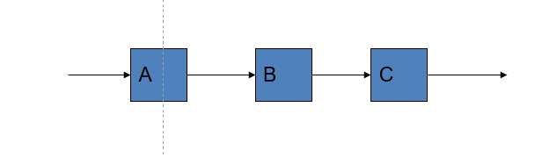
Pipelining Concept
Linear Pipeline Structure:
Linear cascade of processing stages
Performs a fixed function – static pipeline
Stream of data flows from one end to another
Serial vs Pipelined Execution:
Jobs
Jobs
…
1
2
…
k
1
2
k
1
2
…
k
1
2
…
k
1
2
…
k
…
1
2
k
Time
Time
Without Pipelining
One completion every k time units
With Pipelining
One completion every 1 time unit

Slide 10
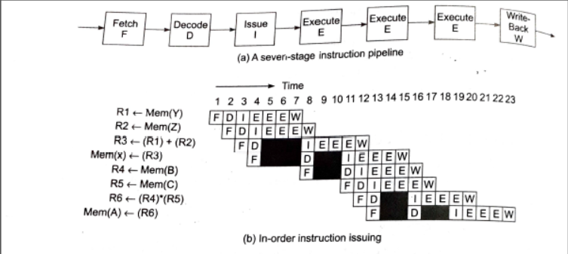
Instruction Pipeline Example
An Example of seven-stage instruction pipeline
Fig 1. 7-stage instruction pipeline [source: Hwang, Jotwani]

Slide 11
Multiple Issue Processors
Ideally, pipelined execution of an instruction stream in a RISC scalar processor can bring the average CPI (Clock Cycle Per Instruction) down to 1.
But, can we achieve CPI < 1 ?
Techniques invented to get CPI < 1:
Super-pipelining
Superscalar
VLIW (Very Long Instruction Word)

Slide 12
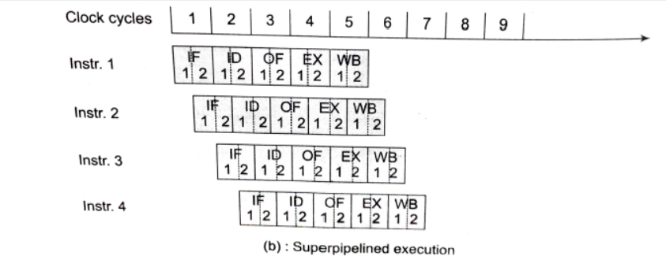
Super-pipelined Architecture
Pipeline stages are sub-divided into multiple sub-stages
Thus, number of instructions supported at any given moment increases and so, speed-up factor is improved
Limitations on the number of stages:
Number of stages cannot increase indefinitely due to practical constraints on costs, control complexity, circuit implementation and packaging limitations.
Increasing the number of stages over the optimal number of stages would reduce the pipeline’s performance/cost ratio.
Fig 4. Super-pipeline execution [source: T.K Ghosh]

Slide 13
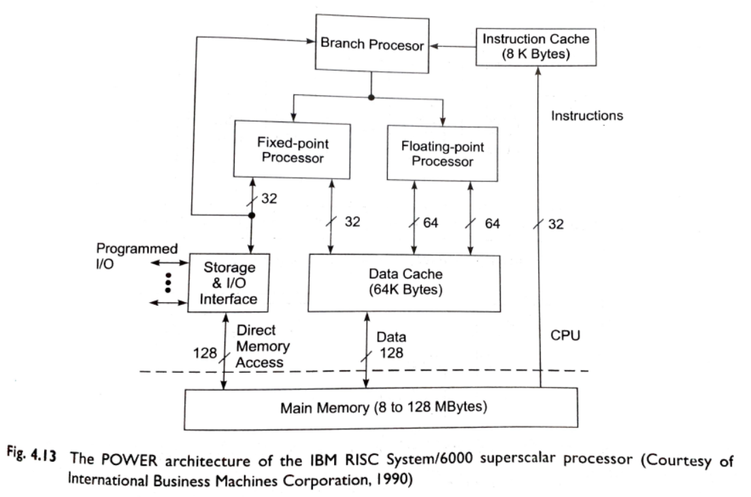
Superscalar Architecture
Several instructions can be initiated simultaneously and executed independently.
In an m-issue superscalar processor:
m-instructions can be issued simultaneously per cycle
The instruction decoding and execution units are increased to form effectively m pipelines operating concurrently.
At some stages, the functional units may be shared by multiple pipelines.
Fig 2. Superscalar architecture example [source: Briggs, Jotwani]

Slide 14
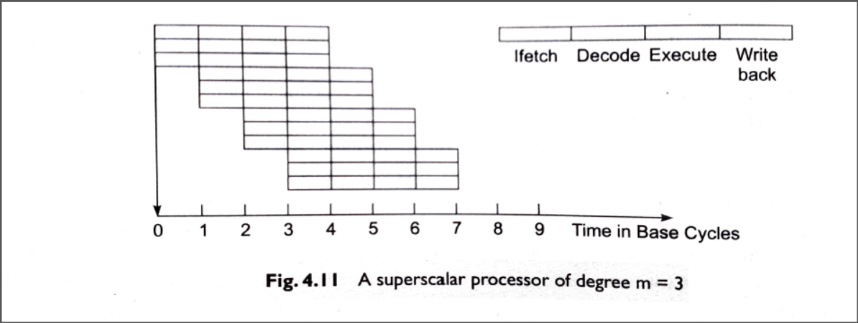
Superscalar Architecture
The effective CPI is less than RISC scalar processors as it allows several instructions to be issued and completed per clock cycle
Limitation: Hardware cost and complexity of design
Fig 3. Superscalar processor pipelining [source: Briggs, Jotwani]

Slide 15
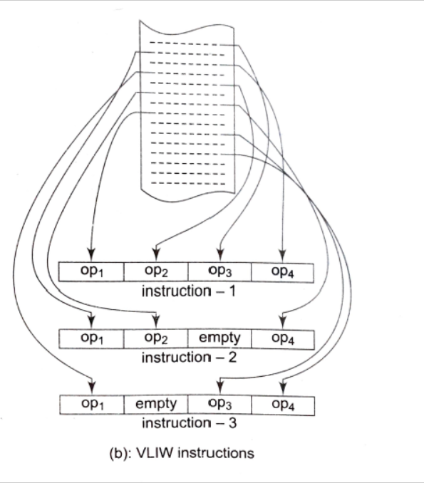
VLIW Processor
The operations to be simultaneously executed are synchronized in a single VLIW instruction
VLIW (Very Long Instruction Word) Processor rely on compile time detection of parallelism
VLIW instruction words are hundreds of bits in length
Multiple functional units run concurrently to perform the simultaneously issued operations
No hardware needed for run-time detection of parallelism
Performs well in special purpose computers where program behavior is more predictable
Fig 5. VLIW instruction [source: T. K Ghosh]

Slide 16
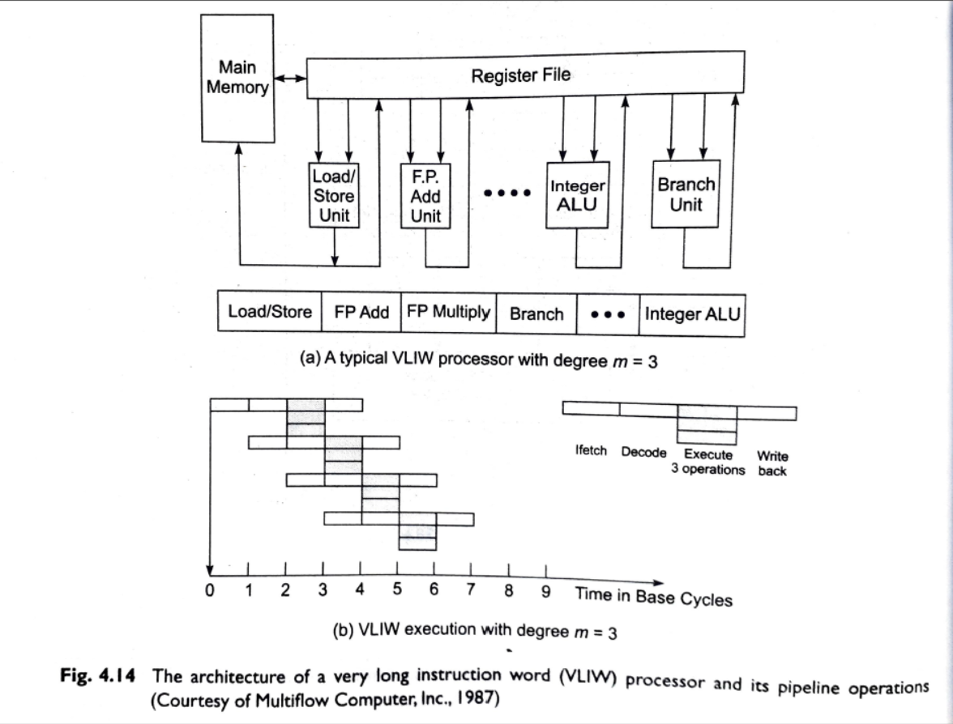
VLIW Processor – contd.
Fig 6. VLIW processor architecture [source: Briggs, Jotwani]

Slide 17
Vector Processor
A vector processor is specially designed to perform vector computations
What is a vector?
A vector operand is an ordered set of same type scalar data items, stored in memory
The number of data elements in a vector determines the length of vector
The addressing increment between successive elements is fixed – called vector stride
To access a vector in memory a vector instruction must specify base address, stride and length.
Vector processing – arithmetic or logical operations on vectors

Slide 18
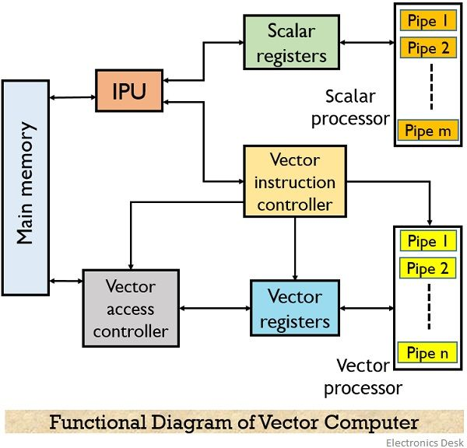
The functional units of a vector computer are as follows:
IPU or instruction processing unit
Vector register
Scalar register
Scalar processor
Vector instruction controller
Vector access controller
Vector processor

Slide 19
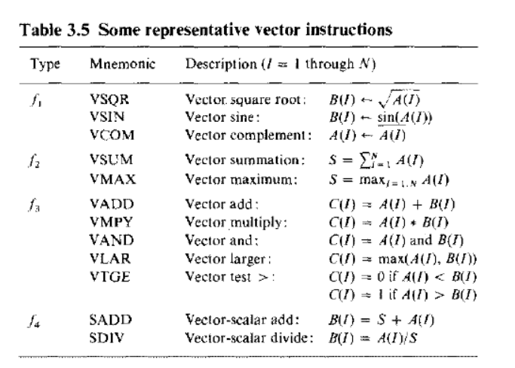
Vector Instruction Types
Vector-Vector instruction
Unary operation: f₁ : V -> V
Binary operation: f₃: V x V -> V
Vector-Scalar instruction
Unary operation: f₂: V -> S
Binary operation: f₄: V x S -> V
Fig 7. Representative vector instructions [source: Hwang, Briggs]

Slide 20
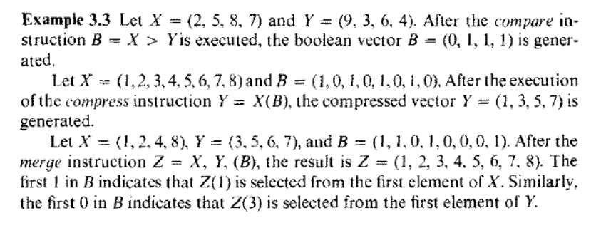
Vector Instruction Types
Fig 8. Examples of special vector operations [source: Hwang, Briggs]

Slide 21
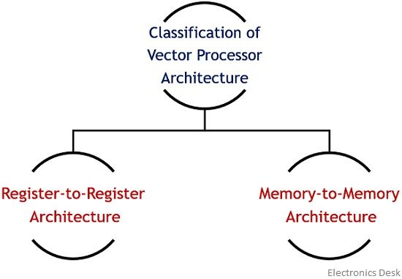

Slide 22
Vector Processor Classification
A vector processor is an ensemble of
vector registers, functional pipelines, processing elements and register counters.
Vector processors can be classified as:
Memory-to-memory architecture – source operands, intermediate and final results are retrieved directly from the main memory
Register-to-register architecture – operands and results are retrieved indirectly from the main memory through vector register files and/or scalar registers

Slide 23
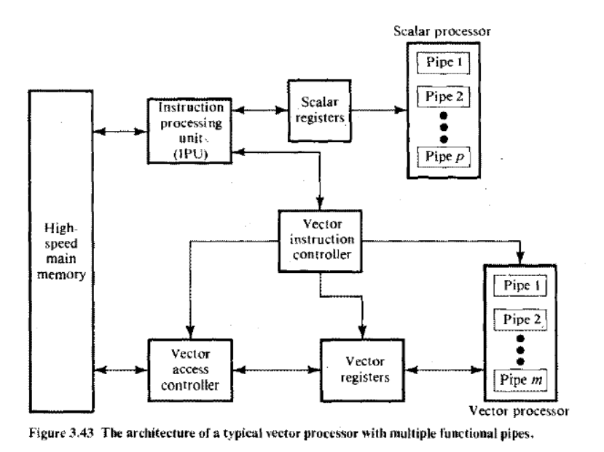
Vector Processor Architecture
IPU : Fetches and decodes scalar and vector instructions
Vector Instruction Controller: supervises execution of vector instructions
Vector access controller: fetches vector operands from memory
Vector register: Used to close up the speed gap between memory access and vector processor
Fig 9. Vector processor architecture [source: Hwang, Briggs]

Slide 24
Vectorizing Compiler
A vectorizing compiler can take a sequential (scalar) program and create a set of vector instructions by converting language constructs like loop, recurrence computation etc.
The conversion from scalar code to vector code is called vectorization.
E.g. Vectorization of For loop in scalar code:
For i=1 to N do A(i) = B(i) * C(i)
Equivalent Vectorized code: A[1:N] = B[1:N] * C[1:N]

Slide 25
SIMD Array Processors
An array processor is a synchronous array of parallel processors and consists of multiple processing elements (PEs) under the supervision of one control unit (CU).
Can handle single instruction, multiple data (SIMD) streams.
SIMD machines are especially designed to perform vector computations over large matrices or arrays of data.

Slide 26
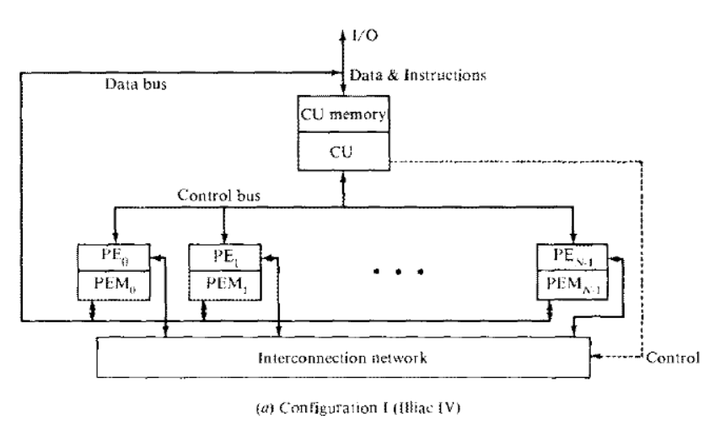
Architectural Configuration of Array Processor
Configuration 1: Illiac IV configuration
Fig 10. Illiac IV configuration [source: Hwang, Briggs]

Slide 27
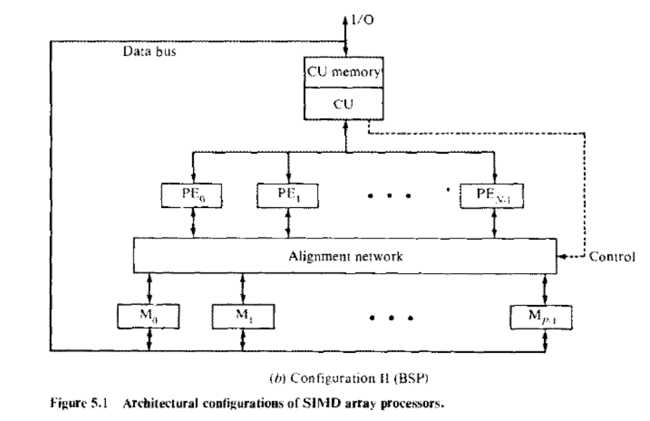
Architectural Configuration of Array Processor – contd.
Configuration 2: BSP configuration
Fig 11. BSP (Burroughs’ Scientific Processor) configuration [source: Hwang, Briggs]

Slide 28
System Design Goals
Important criteria:
Theoretical peak performance of processor
System performance under realistic load conditions
Scalability
Price
Usability
Reliability
Power consumption
Physical size
There should be no performance bottlenecks in the system
Performance bottleneck arises when one of the subsystems cannot keep up with the overall throughput of the system

Slide 29
Instruction Pipeline
Instruction execution can be decomposed into a linear, ordered sequence of operations –
Typically, (i) Fetch, (ii) Decode, (iii) Operand Fetch, (iv) Execute, (v) Write-Back
Each of these operations can be performed in its specific stage hardware at its designated clock-cycle.
So, these operations can be performed in an overlapped fashion in a 5-stage pipeline
In an instruction stream, instructions execution is primarily sequential
So, the same sequence of operations are expected to occur repetitively
In an instruction pipeline, a stream of instruction can be executed in an overlapped manner.

Slide 30
Explain throughput Explain CPI?
Predict how to calculate CPI Demonstrate Clock Rate
Demonstrate Instruction Count Produce the factors on which the performance of a computer depends.
Illustrate how to measure Speedup of a computer Illustrate how to How to measure Efficiency of a computer
Solve Locality of Reference
Evaluate Temporal Locality
Reframe MIPS Explain clock cycle time Explain clock period
how to calculate instruction count
how to calculate clock cycle time
how to calculate clock rate
Compare superscalar, super pipeline and VILW techniques.
Explain multiple issue processorsand their working principle
Briefly describe the VLIW processor architecture with a proper block diagram.
Summerize the advantages and disadvantages of VLIW architecture
Summerize advantages and disadvantages of super-pipeline architecture
Summerize the advantages and disadvantages of super-scalar architecture
Reframe how does superscalar, super pipeline and VILW architecture helps to improve performance of a computer
Prove that in super-pipeline architecture CPI is exactly ½ of the normal pipeline.
Explain time space diagram of super-pipeline technique.
Explain time space diagram of super-scalar technique.
Explain super-scalar architecture with a proper block diagram

